Slide 1
PROJECT FINAL REPORT
DIGITAL IMAGE PROCESSING
SWE1010

Slide 2
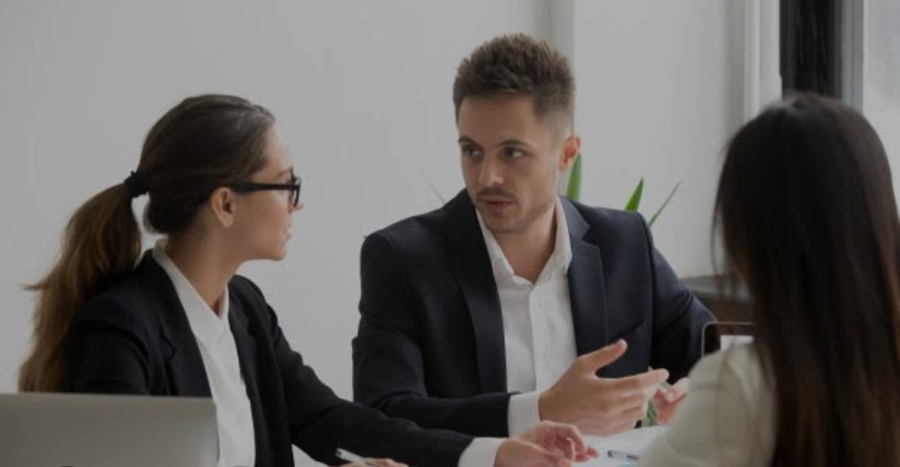
PROJECT TITLE
UNDERWATER IMAGE ENHANCEMENT

Slide 3
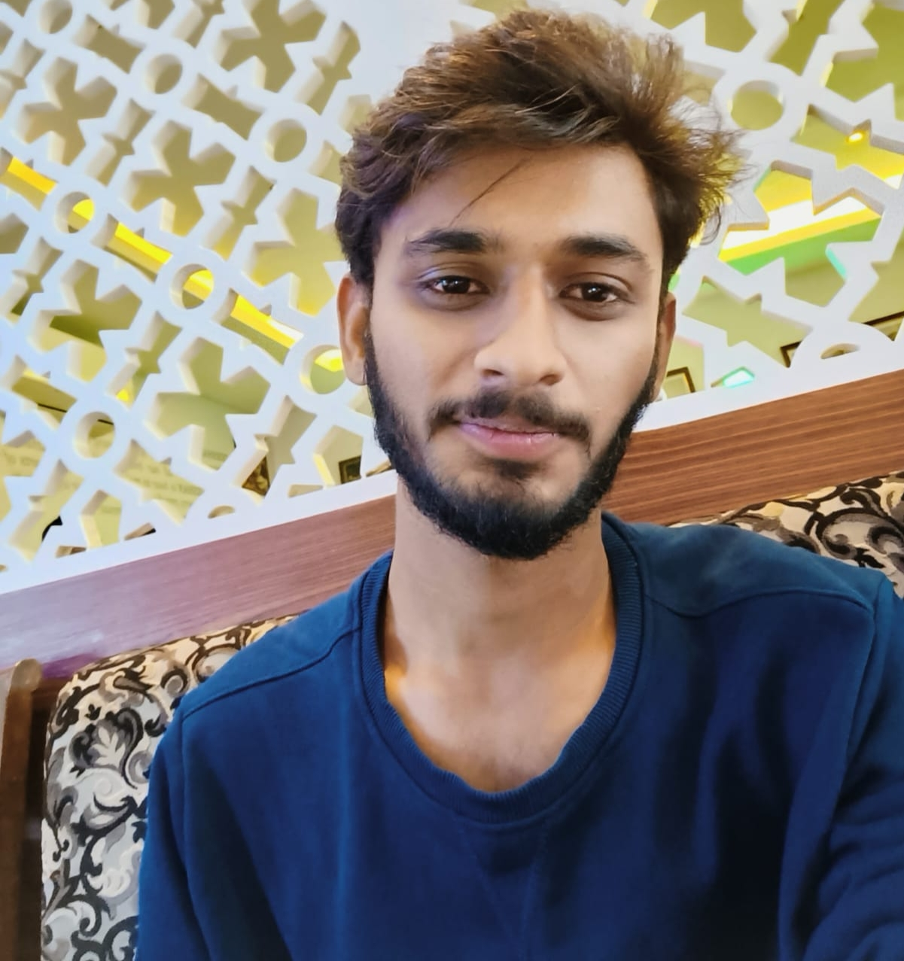
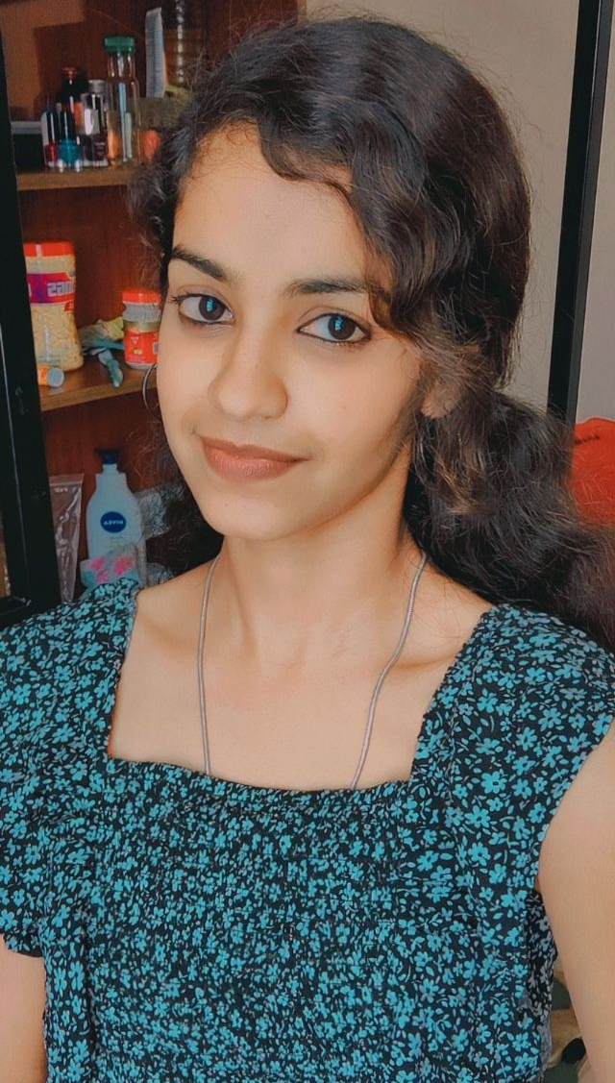
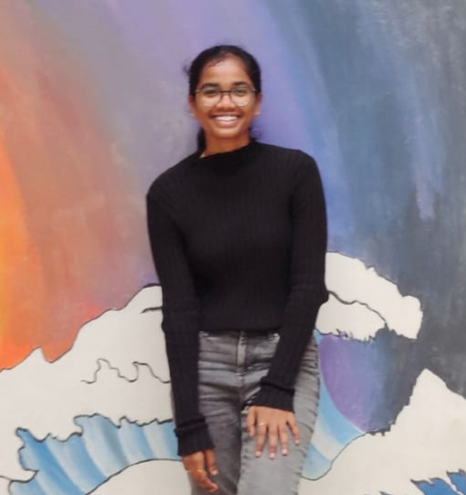
GET TO KNOW OUR TEAM
YESWANTH RAO
20MIS1141
MOUNIKA.M 20MIS1154
YUHITHA VANDANA
20MIS1138

Slide 4
INTRODUCTION
Overview-Background—light undergoes attenuation when it is passed through water. The larger wavelengths are affected more when compared to the shorter wavelengths, thus, images captured underwater appear greenish blue as they lack certain wavelength components extensively. For instance an image acquired at a depth of about 4-5m underwater will lack red wavelength because the longer wavelength components of the visible spectrum is attenuated first. With further increase in depth, other wavelength components also start to lose significance. The images therefore suffer from limited visibility range, uneven lighting, presence of bright artifacts. Noise is inevitably a part of any acquired image. Thus a low contrast image with diminished colour is obtained.

Slide 5
LITERATURE SURVEY
Er. Charanjeet Kaur, Er. Rachna Rajput (May 2015). Ordinary histogram equalization uses the same transformation derived from the image histogram to transform all pixels. This works well when the distribution of pixel values is similar throughout the image. However, when the image contains regions that are significantly lighter or darker than most of the image, the contrast in those regions will not be sufficiently enhanced. The objective is to enhance the underwater images contrast while preserving image brightness. DITHEE DEV K, Mr. S.NATRAJAN (April 2015). One of the effective method used to improve the underwater image is the contrast limited adaptive histogram equalization (CLAHE) technique. From the underwater input image calculate the dark channel and is processed under the image segmentation. Then find out whether it contains the influence of artificial light or not. If it is yes remove it using appropriate method and then go for the CLAHE technique. The experimental results of this method significantly improve the visual quality of underwater images by enhancing contrast as well as the noise and artifacts.

Slide 6
METHODOLOGY ALGORITHM
We Used 8 Methods On Underwater Image Enhancement And Image Restoration
CLAHE – Contrast limited adaptive histogram equalization
FUSION – MATLAB – Enhancing underwater images and videos by fusion
GC – Gamma Correction
HE – Image enhancement by histogram transformation
ICM – Underwater Image Enhancement Using an Integrated Colour Model
UCM –Enhancing the low-quality images using Unsupervised Colour Correction Method
RAYLEIGH DISTRIBUTION –Underwater image quality enhancement through composition of dual-intensity images and Rayleigh-stretching
RGHS – Shallow-Water Image Enhancement Using Relative Global Histogram Stretching Based on Adaptive Parameter Acquisition

Slide 7
ABOUT THE DATASET AND PROPOSED MODEL
The following sections present the network architecture and specification of the proposed GAN-based model for fast underwater image enhancement, which we refer to as FUnIE-GAN. In addition, we provide detailed information about the proposed EUVP (Enhancement of Underwater Visual Perception) dataset. Specifically, the outputs of each encoders are concatenated to the respective mirrored decoders. This idea of skip-connections in the generator network is shown to be very effective [23, 7, 12] for image-to-image translation and image-quality enhancement problems. In FUnIE-GAN, however, we employ a much simpler model with fewer parameters in order to achieve fast inference. The input to the network is set to 256×256×3 and the encoder (e1-e5) learns only 256 feature-maps of size 8×8. The decoder (d1-d5) utilizes these feature-maps and inputs from the skip-connections to learn to generate a 256×256×3 (enhanced) image as output. The network is fully-convolutional as no fully-connected layers are used. Additionally, 2D convolutions with 4×4 filters are applied at each layer, which is then followed by a Leaky-ReLU non-linearity

Slide 8
REQUITEMENTS
SOFTWARE REQUIREMENTS
The above experiments are performed on MATLAB.
Python, Tensor flow etc Packages.
The choice of software is justified because of its well built image processing toolbox, providing wide range of functions.
HARDWARE REQUIREMENTS
Laptop With 6GB RAM

Slide 9
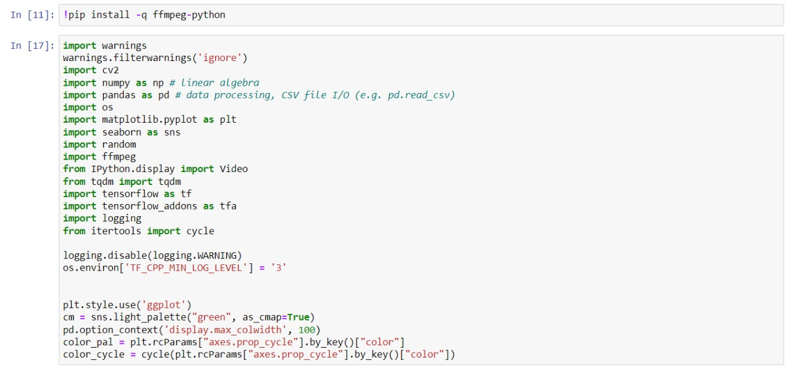
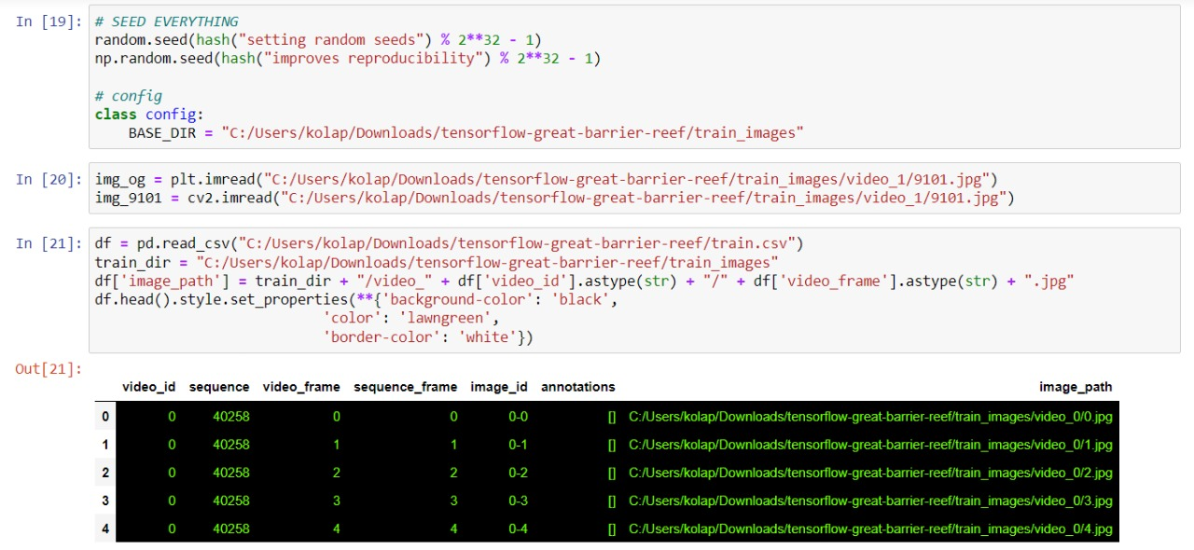
EXPERIMENTAL RESULTS

Slide 10
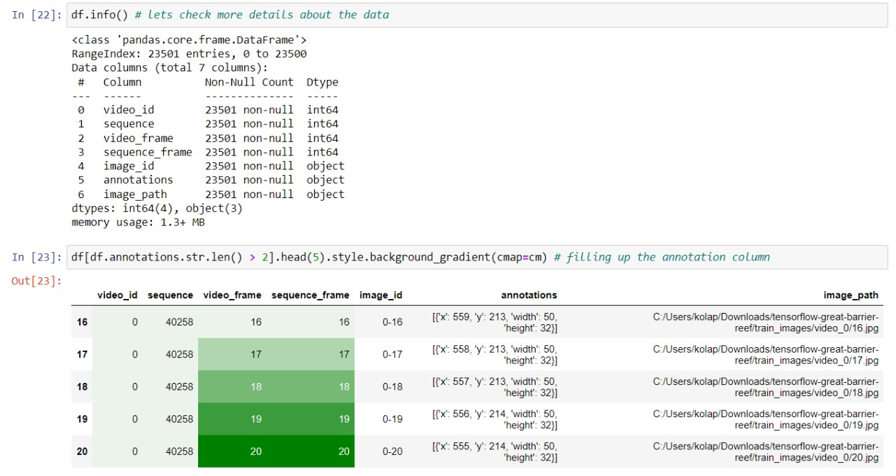
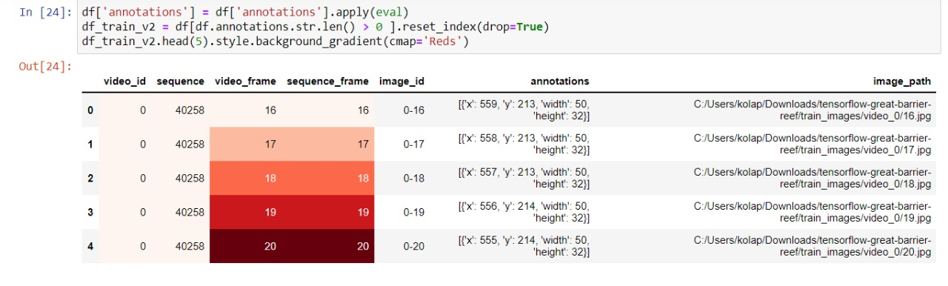

Slide 11
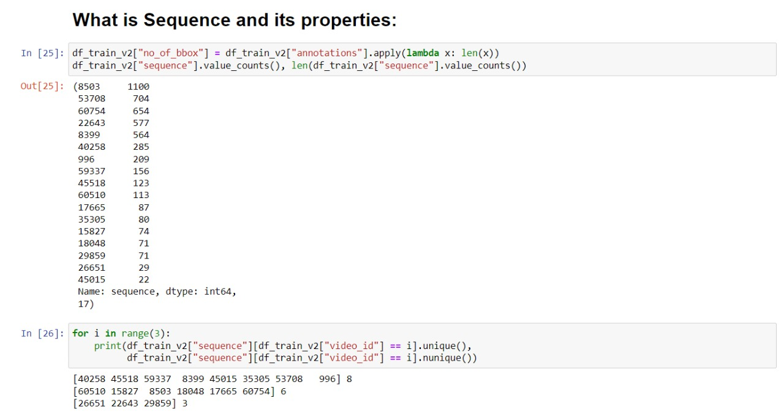
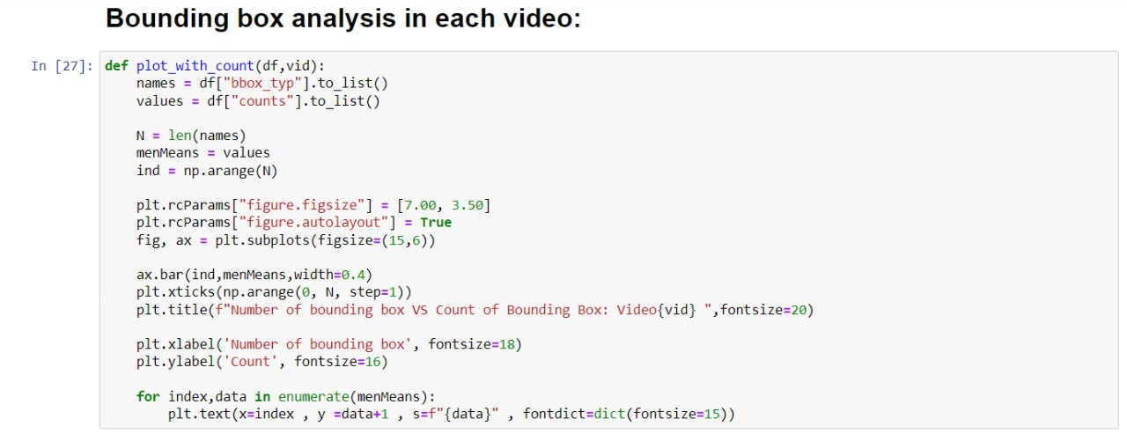

Slide 12
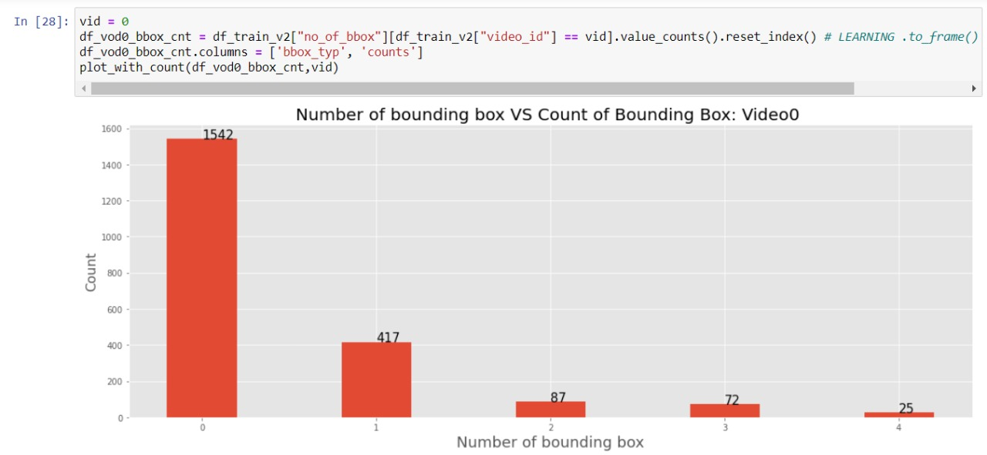
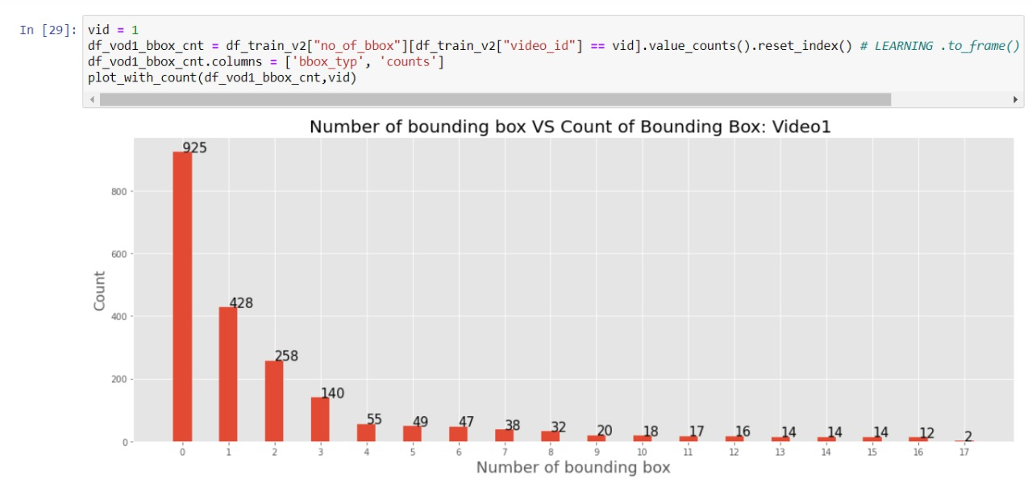
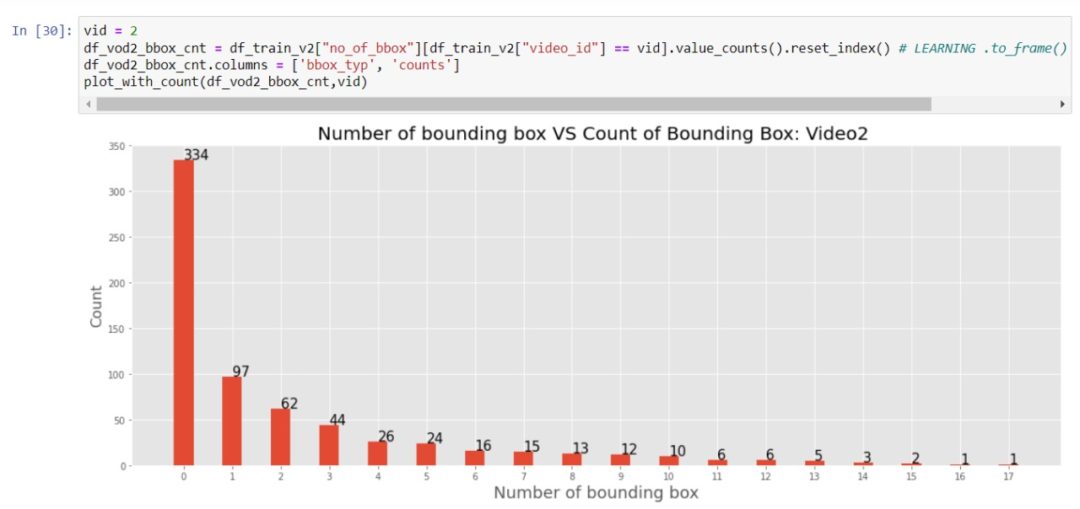

Slide 13
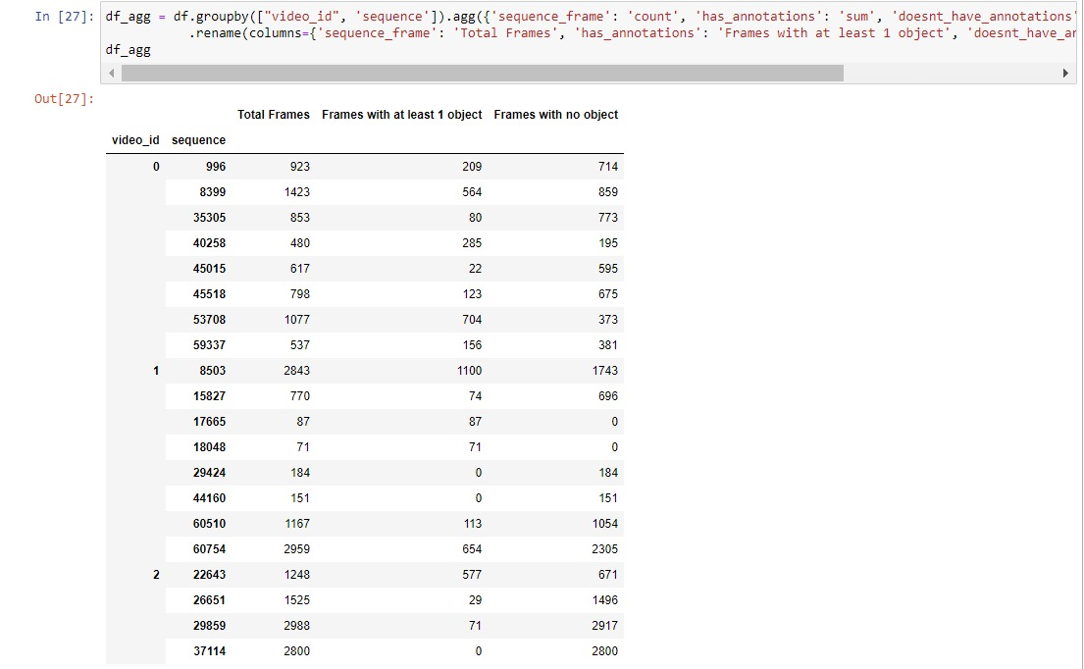
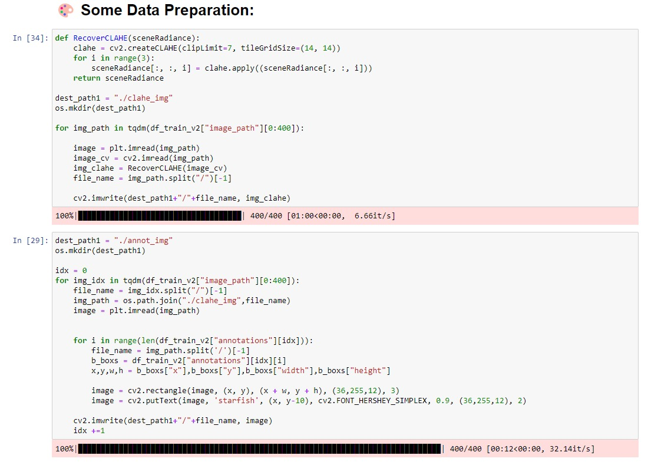

Slide 14
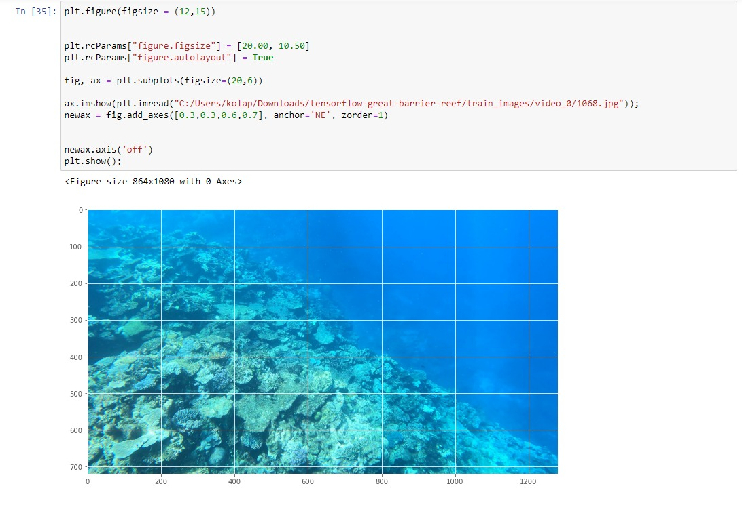
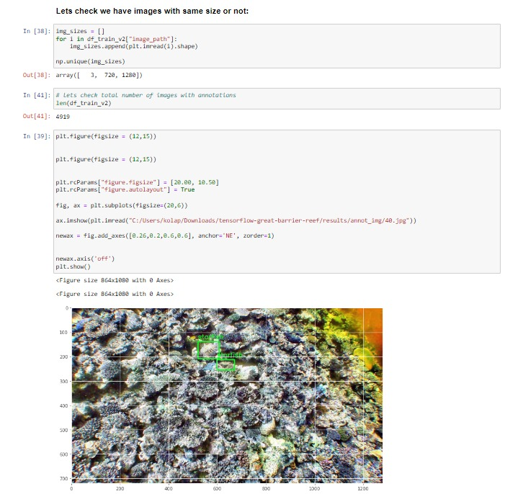

Slide 15
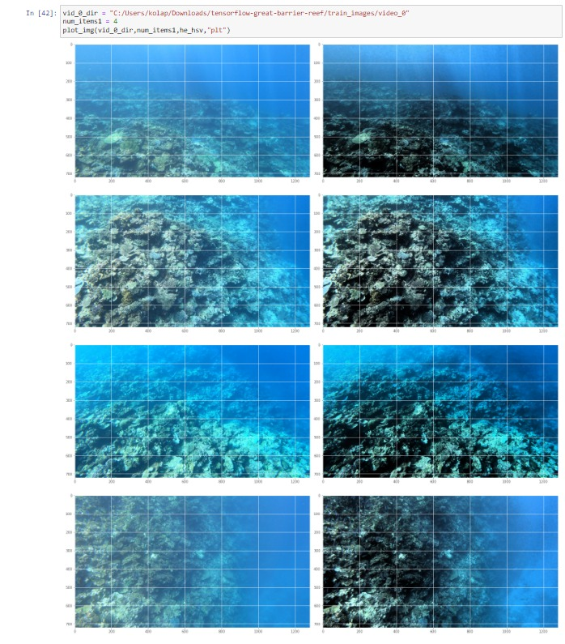
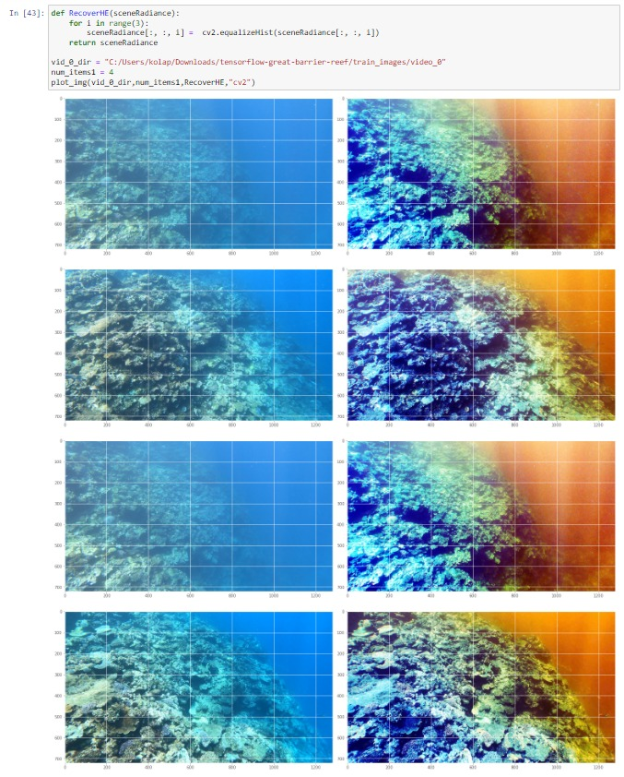
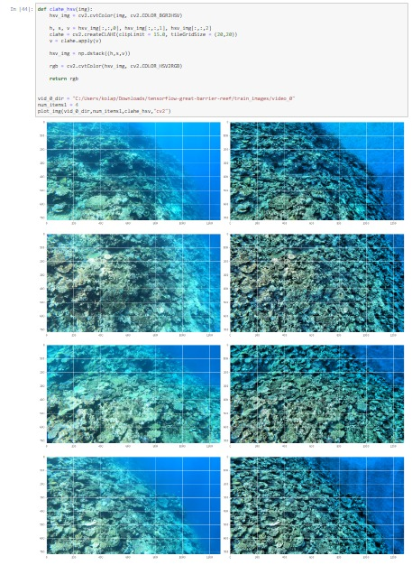
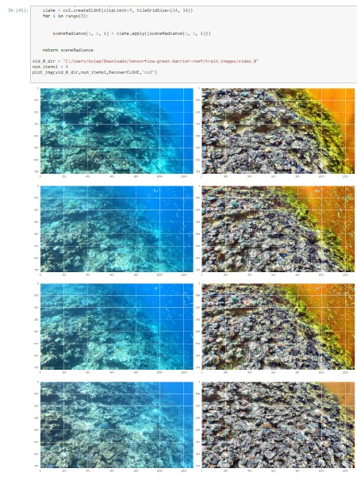

Slide 16
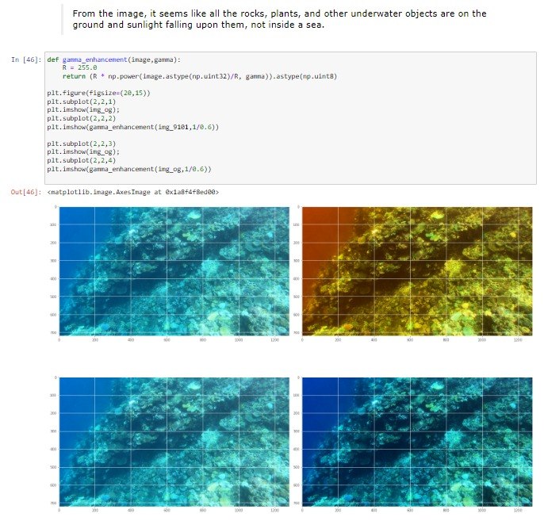
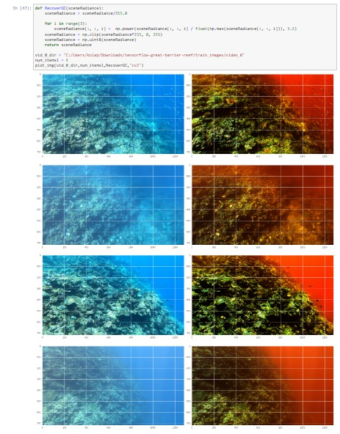
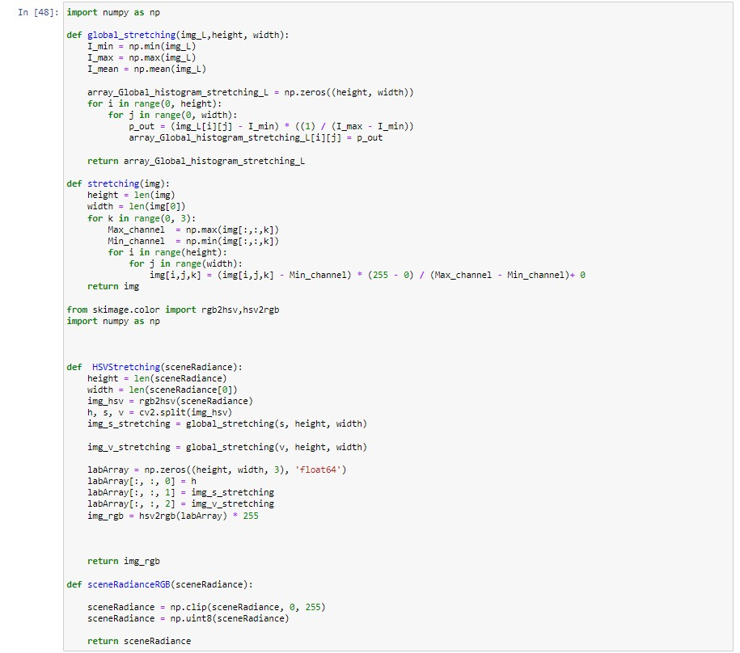
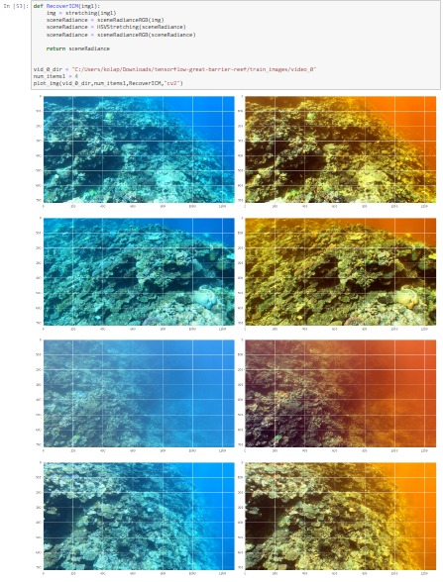

Slide 17
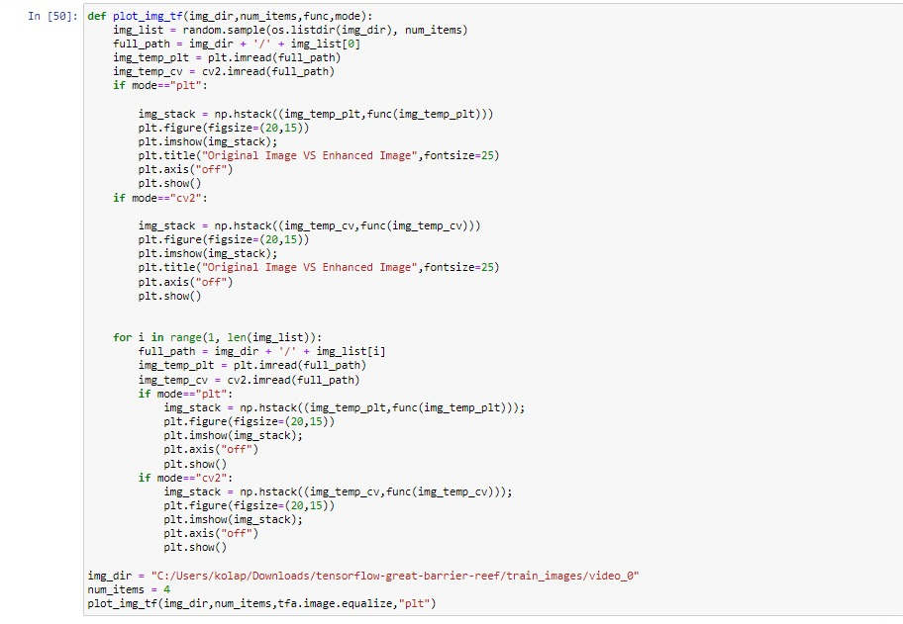
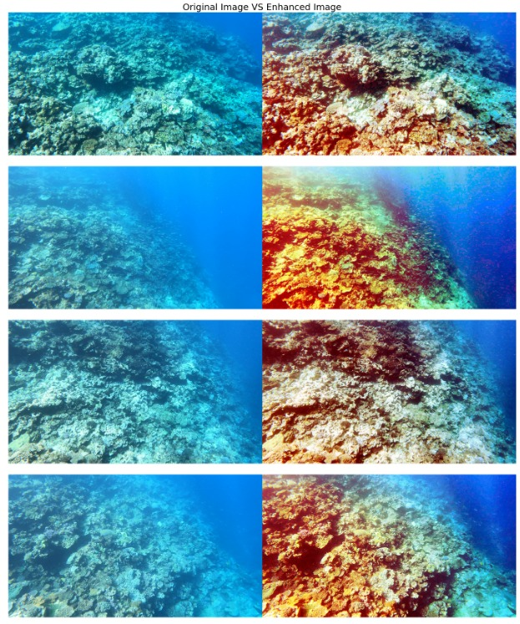

Slide 18
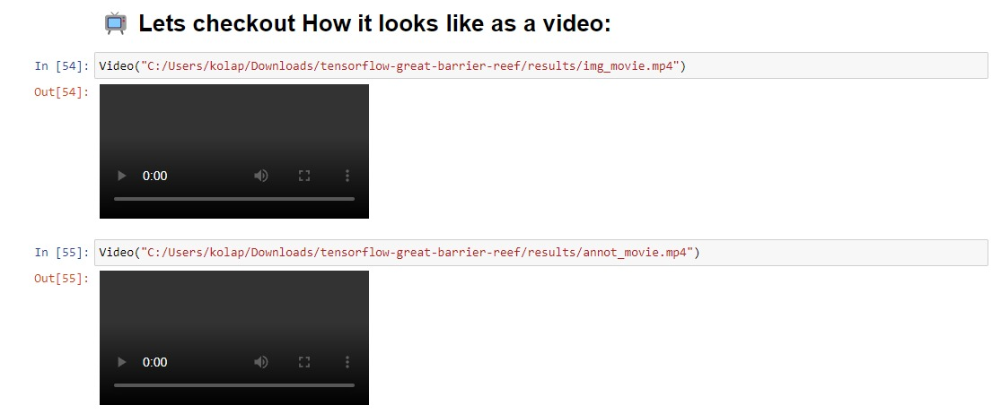

Slide 19


